Slide 1
Business Intelligence
#1 Course Introduction

Slide 2
Agenda
About the course
Competing on analytics
Intro to tool

Slide 3


Teacher
Astrid Hanghøj
Cand. oecon, Ph.D.
E-mail: ahan@via.dk
https://www.linkedin.com/in/astridhanghoej/

Slide 4
Course description
”Kursets formål er at give den studerende de professionelle færdigheder til at levere BI-løsninger med et alment tilgængelige BI-værktøjer.”
See course description on Itslearning and Studynet

Slide 5
Expectations
Four lessons one time per week for 12 weeks = 36 hours
5 ECTS = 140 hours à 8 hours/week outside scheduled lessons
Be mentally present
Work hard, but have fun!

Slide 6
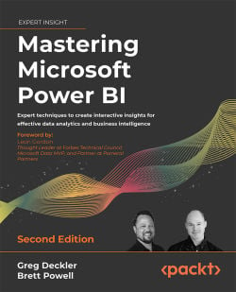
Course book
Quite a lot of reading for the course. Tutorials mixed in with theory. Skim-read as prep – deep read as needed for exercises.
Know that all chapters listed in the course plan is curriculum for the exam.
https://www.packtpub.com/product/mastering-microsoft-power-bi-second-edition/9781801811484

Slide 7


Adventure Works
You will be helping Ken Sanchez, Peter Krebs, David Bradley, and Mary Gibson becoming more data informed employees of Adventure Works
At the end of the semester, you will have provided all of them with valuable reports as they will request (next time)

Slide 8
Course Overview
Planning BI projects and Getting Data
Requirements gathering
Ownership
Deployment models
Data modelling
Data profiling
Getting data
Data Models and M-queries
Dataset Layers
M-Queries
Data model
Metadata
Documentation
DAX
DAX Context
Measure / Calculated Columns
Common DAX functions
Performance analyzer
Security Roles
Report Planning
Choosing the right visuals
Mobile View
Report Builder
Custom visuals
Maturity
Governance
Adoption
User enablement
Support
Training
Calculation groups
Calculation items
Adoption roadmap
User Training and Tabular Editor
Reports and visualizations

Slide 9
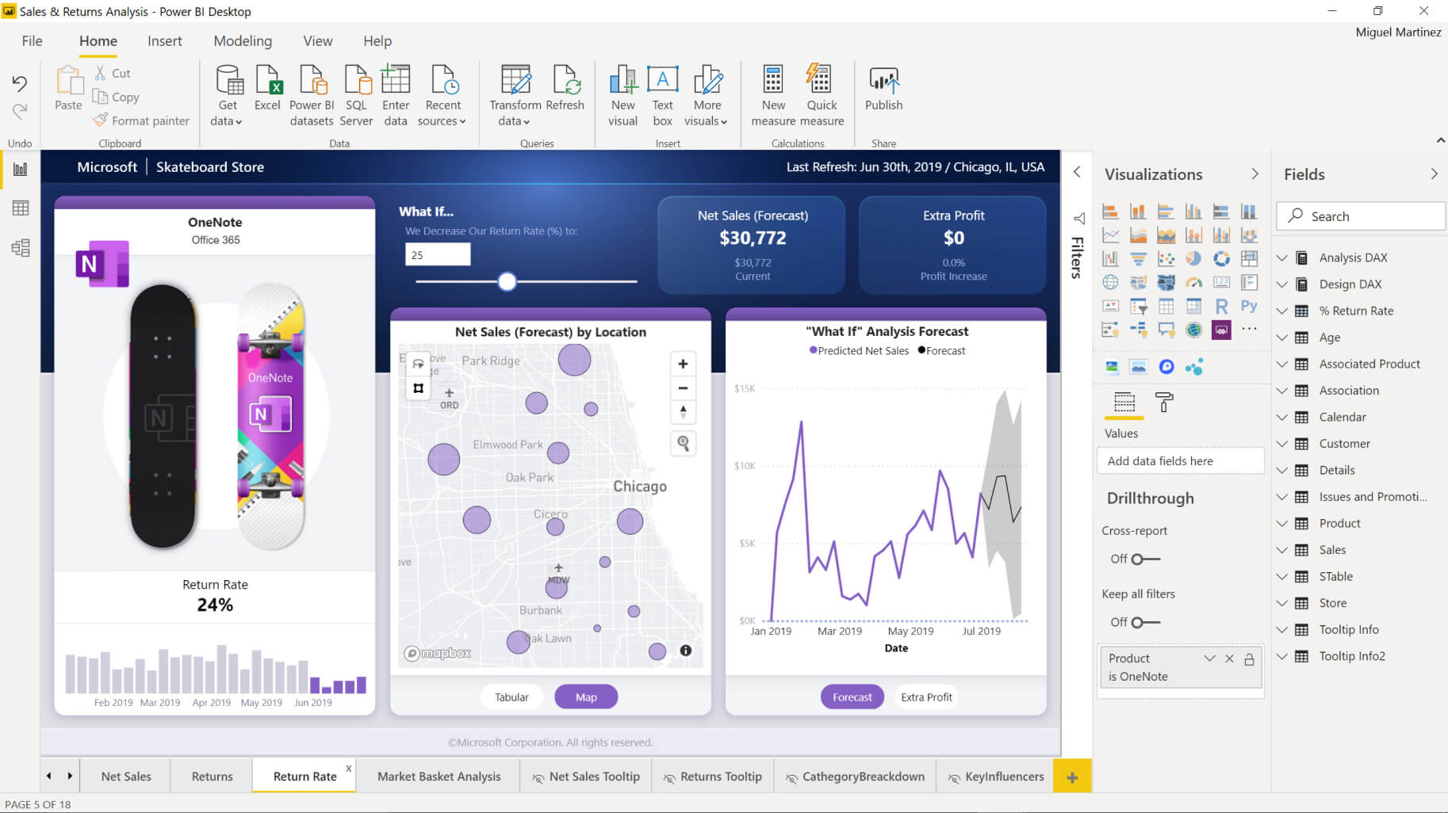
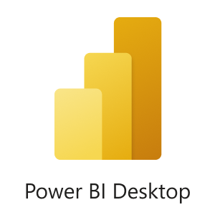
Primary tool: PowerBI
We will use PowerBI desktop to create our Business Intelligence products

Slide 10
PowerBI Desktop
Tabular data model
  In-memory database
Data preparation (native through M query language)
Data modelling
Data transformation
Data visualization

Slide 11
Format
In class
Relevant theory covered together
Exercises solved in groups
Self-study (important!)
Solve exercises (whatever you do not finish in class is homework)
Deliver BI reports to AdventureWorks

Slide 12
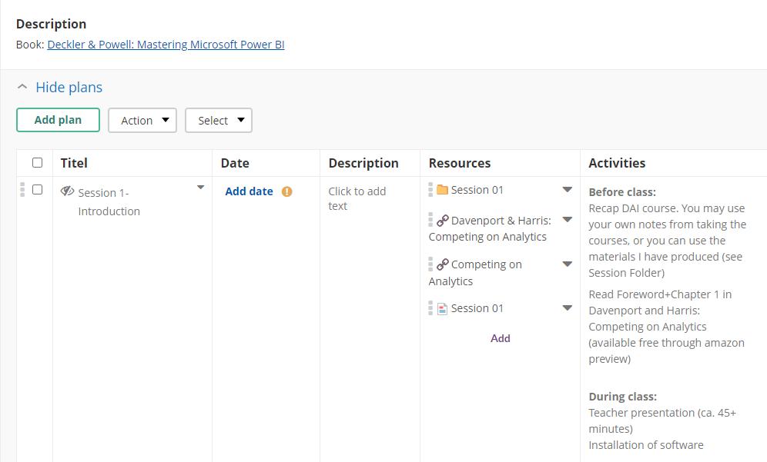
Course Plan

Slide 13
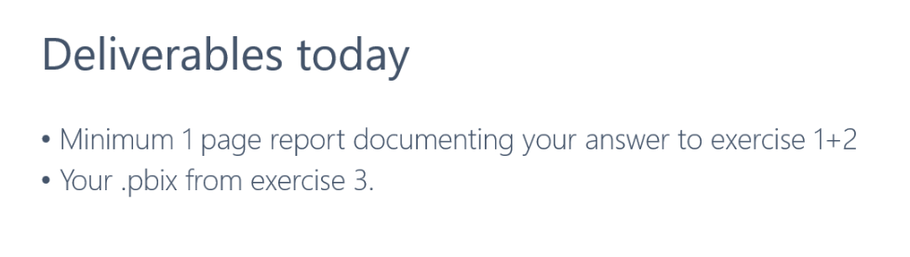
Weekly deliverables
Not mandatory, but *really* helpful for the exam

Slide 14
Exam - Requirements
1 mandatory course project over 2 project days.
  First hand in + improvement.
  You will get feedback on the first draft to help you improve.
1 mandatory training session

Slide 15
Exam - Requirements
1 mandatory course project over 2 project days.
  First hand in + improvement.
  You will get feedback on the first draft to help you improve.
1 mandatory training session

Slide 16
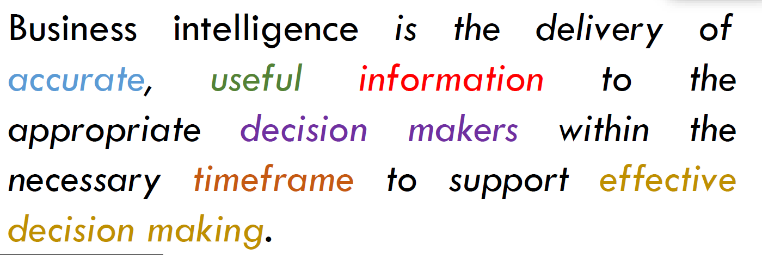
What is Business Intelligence?

Slide 17
Business Intelligence skills - jobmarket
Business Intelligence Developer
  Develop reliable and high performing data sources
  Create front-end solutions, which enable […] organization to make faster and better decisions
  Support and monitor our information systems
  Suggest continuous improvements to our platforms and technologies.
BI Analyst
  Datamanagement, analysis and BI-reporting
  Microsoft PowerBI or similar reporting tool
  Principles behind datamanagement, datamodelling and reporting solutions
  Value of datadriven decisions
  Ability to empathise with end-user to give best possible support
BI Consultant
  MS SQL server
  Business acumen
  Extroverted
  Structured
  Language skills
  Motivation
Business Intelligence Specialist
  Strong knowledge of Power BI and DAX (potentially expert in similar front-end BI tools)
  Knowledge of SQL and data modelling (interest in backend an advantage)
  A good understanding of systems and data flows
  Ambition to engage on a steep learning curve

Slide 18
DELTA model
Data
  Integrated, high-quality, and easily accessible data.
Enterprise
  Manage analytics resources—including data, technology, and analysts—in a coordinated fashion across the enterprise.
Leadership
  Senior leadership commitment.
Targets
  First deep, then broad
Analysts
  Hire and train high-quality quantitative analysts.
Technology
  Adoption of new technological approaches to managing and analyzing data
Analytics techniques
  Sophistication and diversity
Notes:
Data
Analytical companies require integrated, high-quality, and easily accessible data about their businesses and markets. The most analytical firms have distinctive sources and types of data.
Enterprise
Instead of managing their analytics resources in disconnected silos, highly analytical firms manage these resources—including data, technology, and analysts—in a coordinated fashion across the enterprise.
Leadership
One of the key factors driving success in analytics is strong, committed leaders who understand the importance of analytics and constantly advocate for their development and use in decisions and actions.
Targets
Organizations can’t be equally analytical about all aspects of their businesses, so they need to target specific business capabilities and functions for the extensive use of analytics.
Analysts
Analytical organizations succeed in part because they hire and train high-quality quantitative analysts and data scientists.

Slide 19
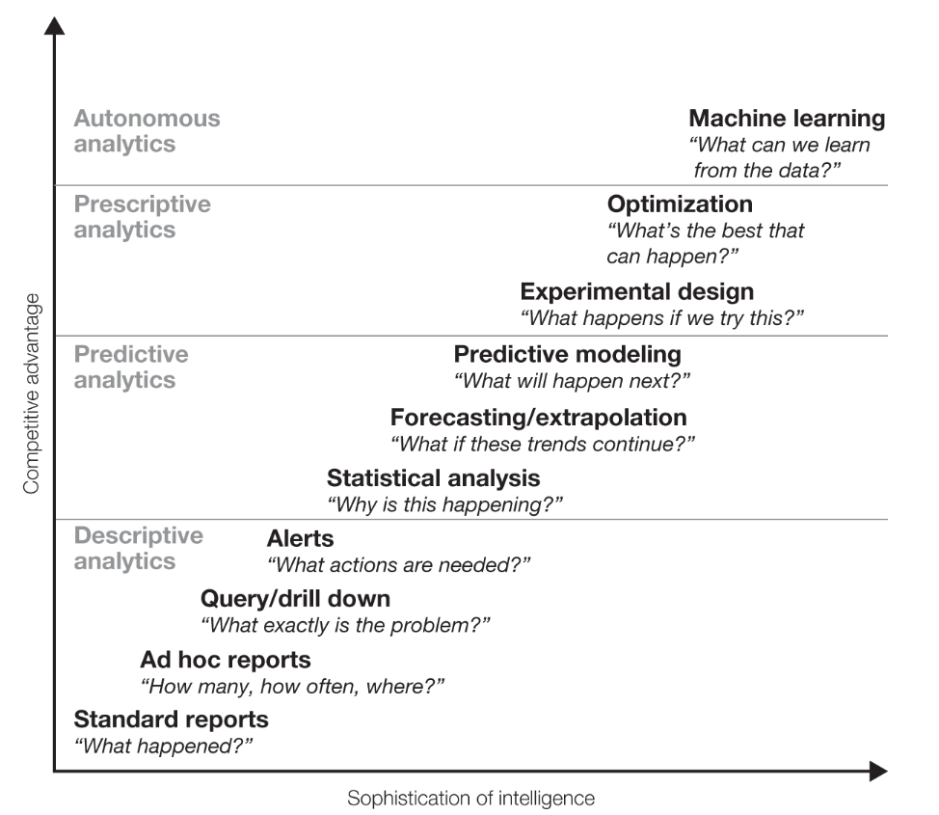
Analytical capability
Barneys VRIO framework:
  Valuable
  Rare
  Inimitable
  Organized
If resources are not valuable, rare, inimitable, then what remains is how your organize your firm to take advantages of commoditized resources.
Analytics capability can help you compete.

Slide 20
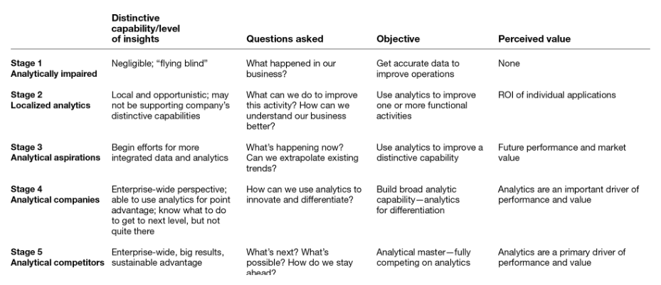
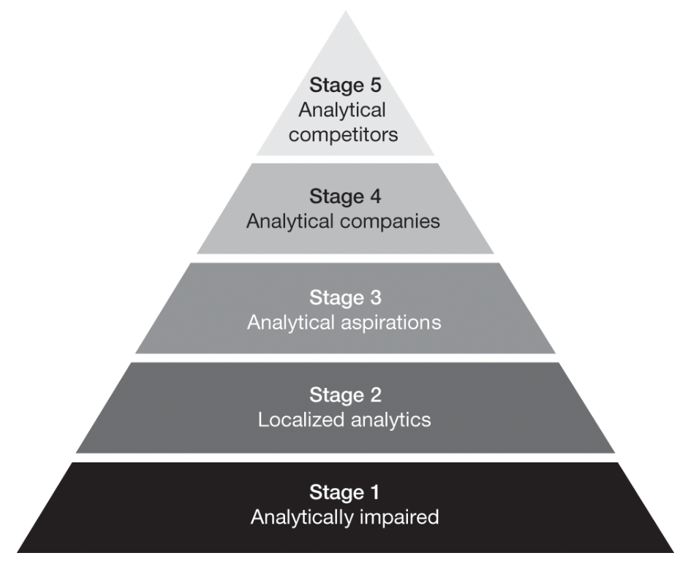
Maturity model

Slide 21
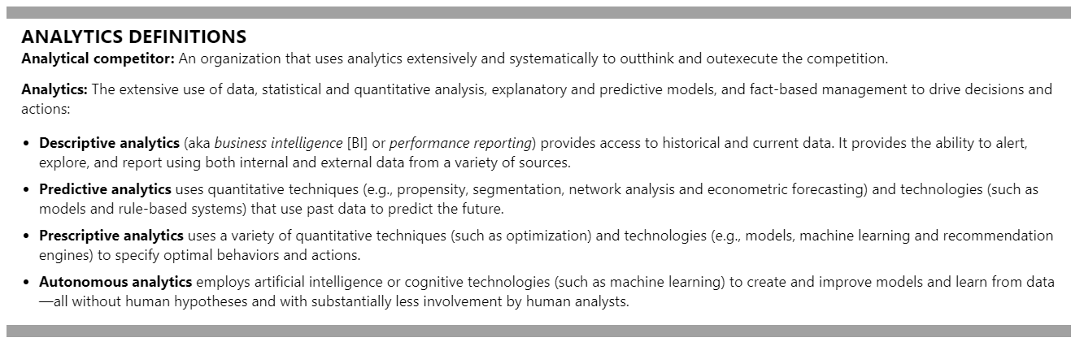

Slide 22
Quick introduction to PowerBI

