Slide 1
Business Intelligence
#02 Planning BI projects

Slide 2
Agenda
Requirements gathering
BI ownership and project roles
Deployment modes
Data modelling
Data profiling
Getting data
  Query folding
  Authentication
  Privacy Levels

Slide 3
Requirements gathering
Data
Requirements
Regulatory
and Compliance
Requirements
Business
Requirements
Functional
Requirements
BI
Requirements
Technical
Requirements
Replacement
Requirement
Notes:
Based on Rick Sherman Fig 3.1

Slide 4

Data Requirements
Revise
Data Quality
Needs
BI
Requirements
Identify
Data Sources
Perform Gap
And Quality
Assesment
Data
Profiling
Regulatory and Compliance
Requirements
Gather
R&C
Requirements
Confirm
R&C
Requirements
Business
Requirements
Gather
Functional
Requirements
Storyboard &
Mockups
Revise
Functional
Requirements
Consolidate
Requirements
Functional Requirements
Gather
Technical
Requirements
Confirm
Technical
Requirements
Technical Requirements
Gather
Replacement
Requirement
Document
Exisitng
Reporting
Revise
Replacing
Reporting
Reverse
Engineer
Replacement Requirement
Notes:
Based on Rick Sherman Fig 3.2

Slide 5

Requirements gathering: 5 W’s

Slide 6
Formulating questions
Natural language
In the form of a question
Easily understandable
Not too high level
Granular enough to be answered with data
Possibly bucked by time

Slide 7
2 types of interviewees
Stakeholder (senior staff)
  Align data efforts with strategy
  Ensure buy-in (and financing)
  High-level understanding
End-user
  More tactical
  Outcome-focused

Slide 8
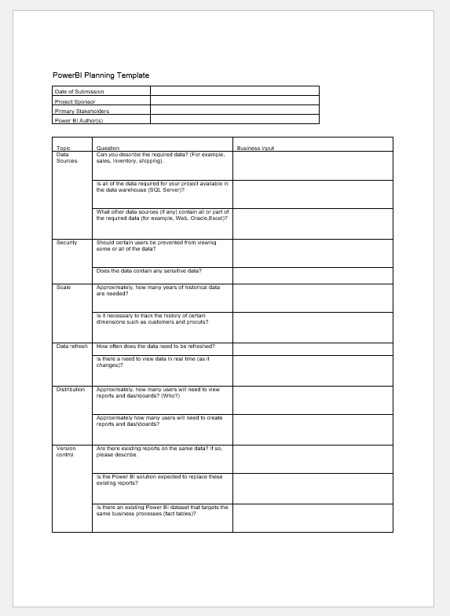
Requirements Gathering
You can use the template provided in the course room
Can be modified to your needs (add more W’s)

Slide 9
Prioritizing outcomes
List the “business value” questions gained from the interviews and score them on the following dimensions:
  Value (impact to business)
  Cost effectiveness (time to complete * hourly rate * people)
  Ease of effort
  Data dimension (availability, quality, etc)
Start with the top-priorities.

Slide 10
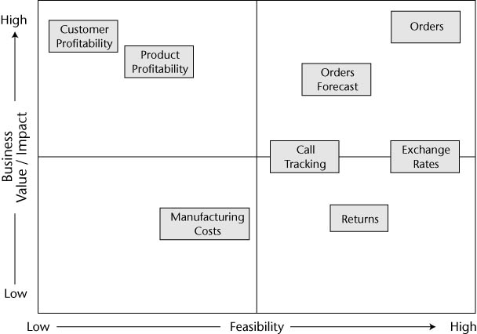
Prioritization Grid

Slide 11
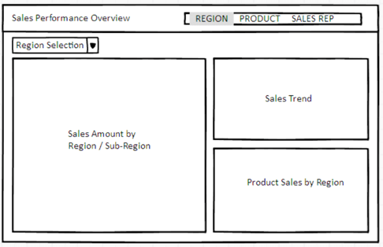
Dashboard mockup
Plan your dashboard

Slide 12
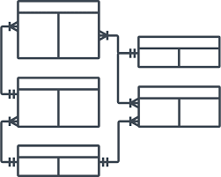


Dataset designer
Report Author
Data Access
  Sources
  Privacy
  M/SQL
  Authentication
Data Model
  Dax
  Security roles
  Meta data
Reports and dashboards
  Design standards
  Interactivity
Mobile experience
Distribution
Support

Slide 13
Deployment Modes
Corporate BI
  Reports and dashboards owned by IT
  Datasets owned by IT
Self-service visualization
  Reports and dashboards owned by business
  Datasets owned by IT
Self-service BI
  Reports and dashboards owned by business
  Datasets owned by business

Slide 14

Corporate IT
Corporate BI
Source
System
Reports
Business User
Source
System
Data
Warehouse
Dashboards
Business User
Source
System
Data
Sets
Power BI
Desktop
Business User
Dataset Designer

Slide 15
Corporate IT
Self-service visualization
Source
System
Reports
Business User
Source
System
Data
Warehouse
Dashboards
Power BI
Desktop
Report Author
Source
System
Data
Sets
Power BI
Desktop
Business User
Dataset Designer

Slide 16
Corporate IT
Self-service BI
Source
System
Reports
Business User
Source
System
Data
Warehouse
Power BI
Desktop
Dashboards
Report Author
Source
System
Data
Sets
Business User
Power BI
Desktop
Dataset Designer

Slide 17
20-40% of all spreadsheets contain errors
Raymond Panko (2005)

Slide 18
20-40% of all PowerBI reports
…probably also…
contain errors

Slide 19
What do you think?
Given that any cognitive domain (programming, spreadsheet development, datamodelling etc) is an error prone activity… What do you think is the best deployment model for BI?
Do you think companies differ in their chosen deployment models?
  Why? What might reasons be to choose one deployment model over another?

Slide 20
Choosing a deployment mode
Important, widely-distributed, reports and dashboards => Corporate IT
Security and version control => Corporate IT
Larger organizations may choose a mix of deployment modes
Questions to ask:
  Who will own the data model?
  Who will own the reports and dashboards?
  How will the content be distributed?
See Planning template

Slide 21
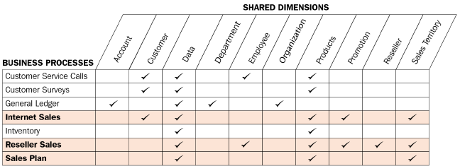
Bus Matrix and Dimensional Design approach (Recap)
Bus matrix
Dimensional design approach
  Select the business process
  Declare the grain
  Identify the dimensions
  Define the facts
  (Draw the star schema)
Prerequisite knowledge from DAI class

Slide 22
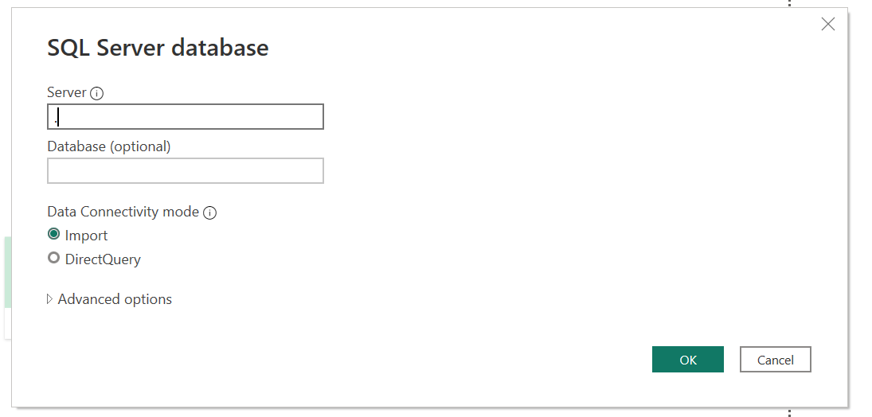
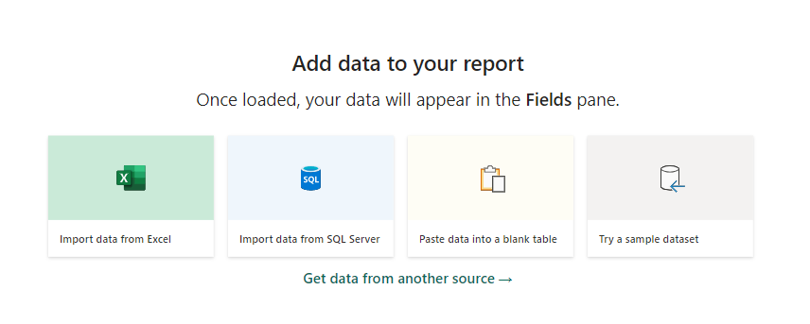
Getting data
Import: Data is loaded into PowerBI report (cached). PowerBI handles the query load completely.
DirectQuery: Data is NOT imported. Requests sent to source. Each report interaction (a user opens the dashboard) is sent as a query to the source.

Slide 23
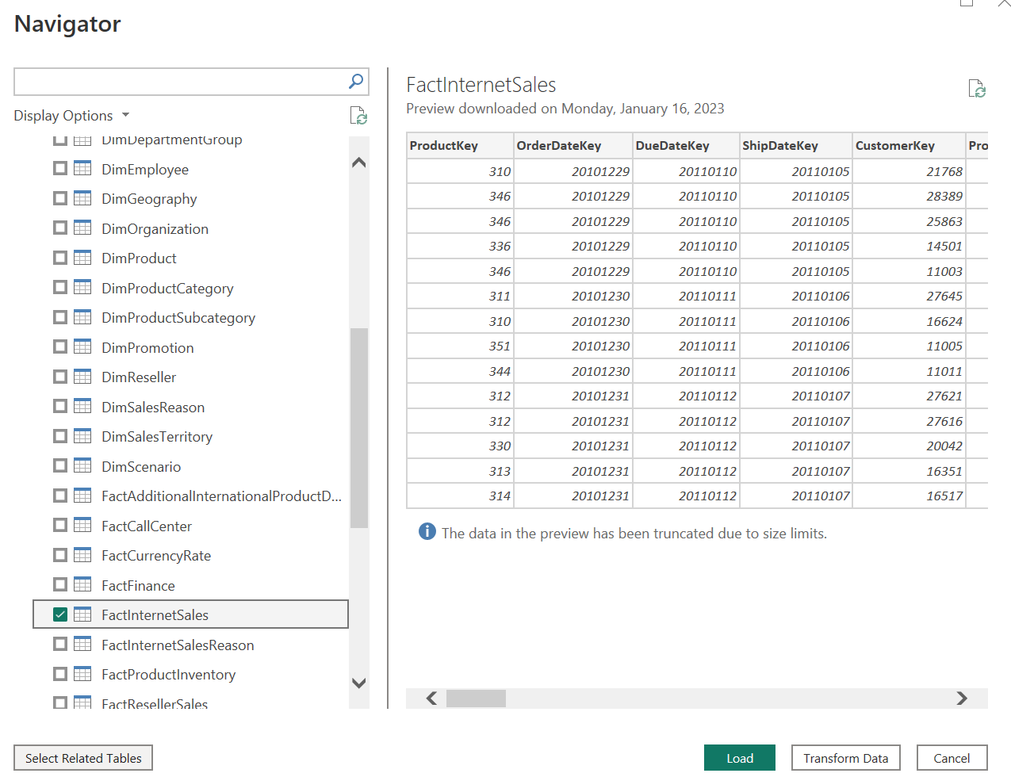
Getting data
Load fact table and associated dimensions

Slide 24


Where to get data from?
Source
System
Views for each BI
data product
EDW Tables
Source
System
Data
Warehouse
Staging Tables
Source
System
Never ever build BI products on top of these

Slide 25
Six places of logic
DATA WAREHOUSE
ELT/ETL Data Transformation Process
Fact and Dimension Tables
SQL Views
M Queries
DAX calculated tables and columns
DAX measures
Where do you think it’s best to place business logic?
POWER BI DESKTOP
Notes:
Deckler Powerll 2.13

Slide 26
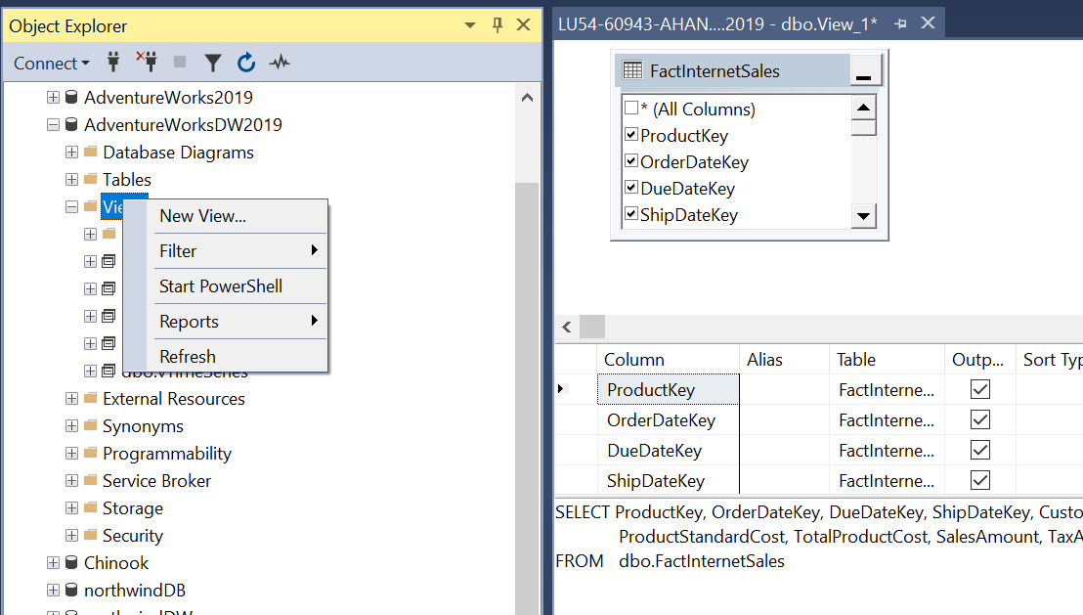
Creating views
In Management Studio, create a view from the Object Explorer
You can decide not to include any columns not relevant for reporting (e.g. flags used in the ETL process or likewise)

Slide 27
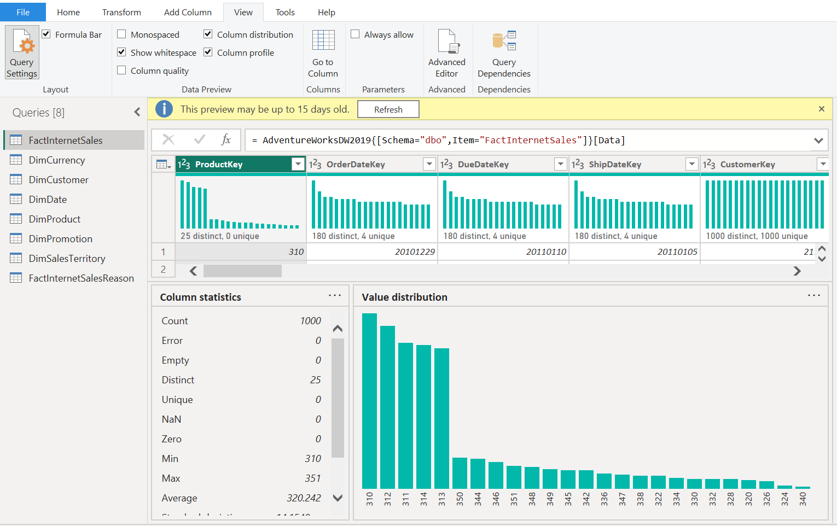
Data profiling
Easy way to check if you have the data to build the reporting solution on.
Do not trust data just because it appears in another reporting solution – it could be disguised in transformations
Think “data quality” from DAI
Notes:
Do n

Slide 28
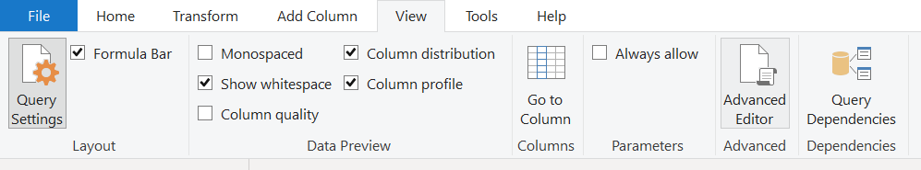
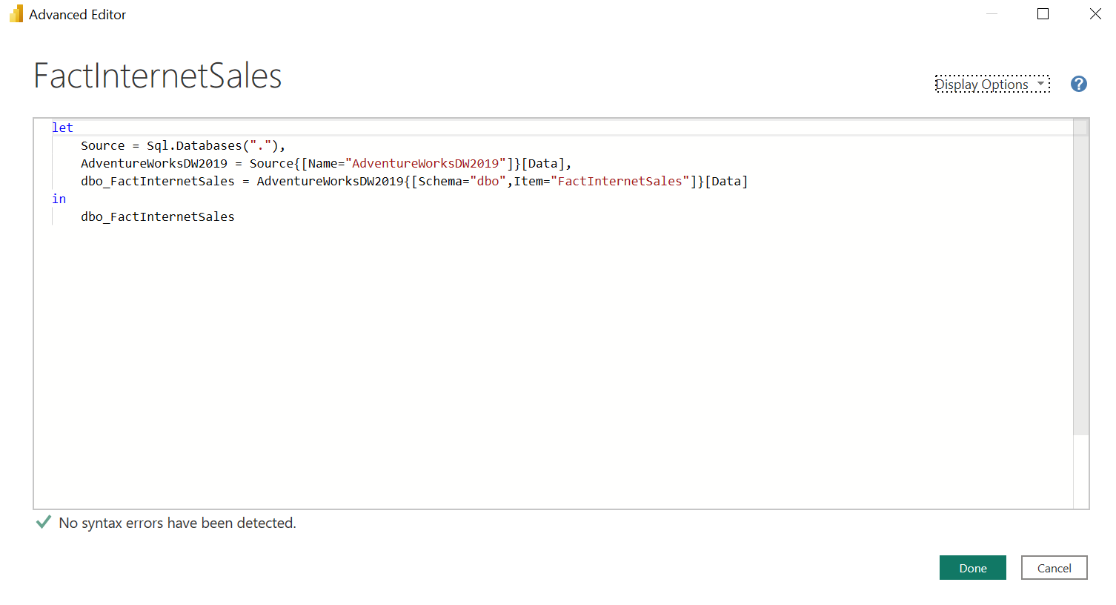
M-Query for simple result
Source is a SQL connection string to localhost
Adventureworks2019 specifies which database to connect to to at [Data] retrieves all the tables in that DB
dboFactInternetSales specifies the table to get and retrieves all the records in that table.

Slide 29
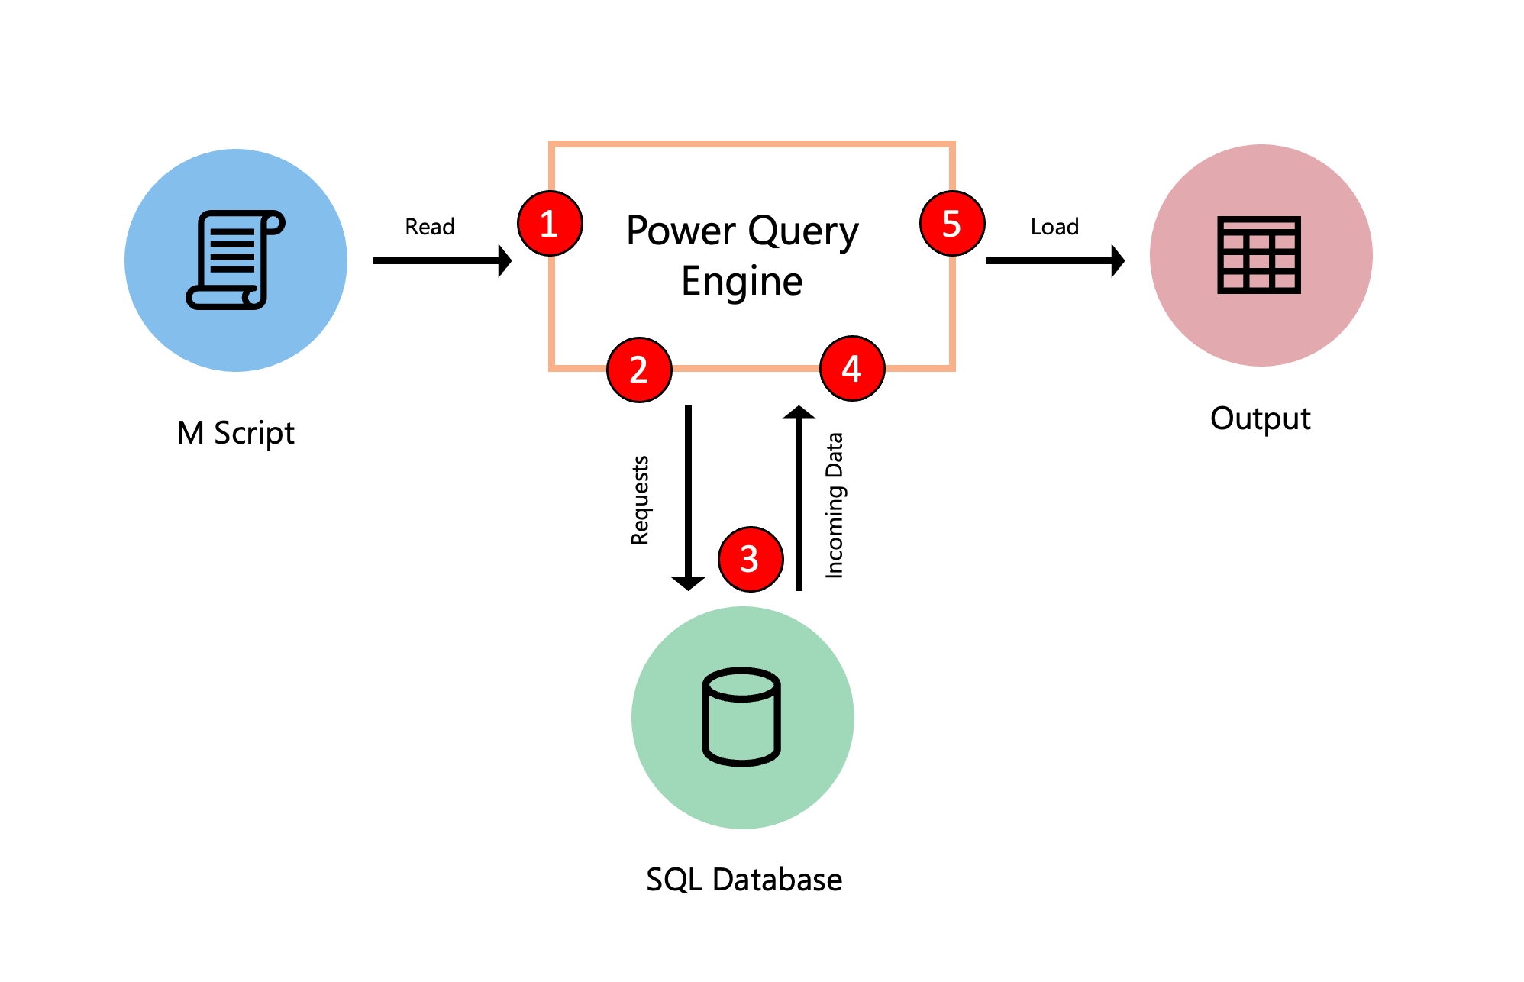
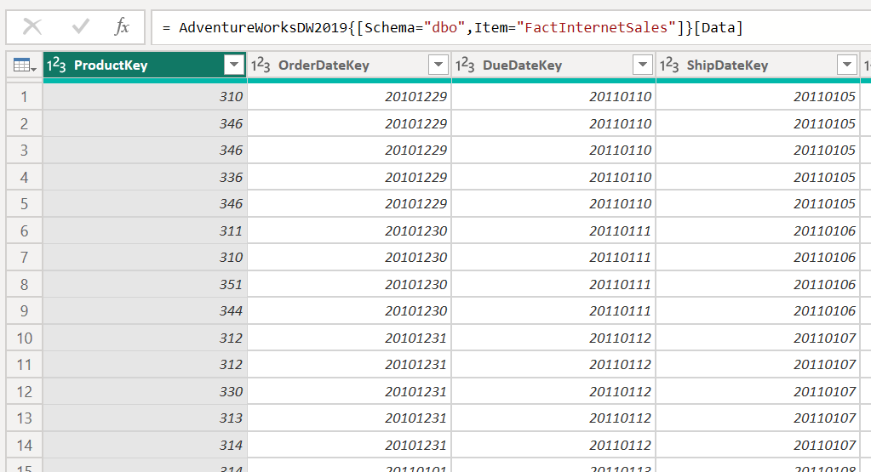
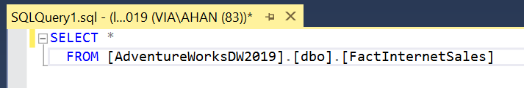
Query evaluation in Power Query
Power BI
Desktop

Slide 30
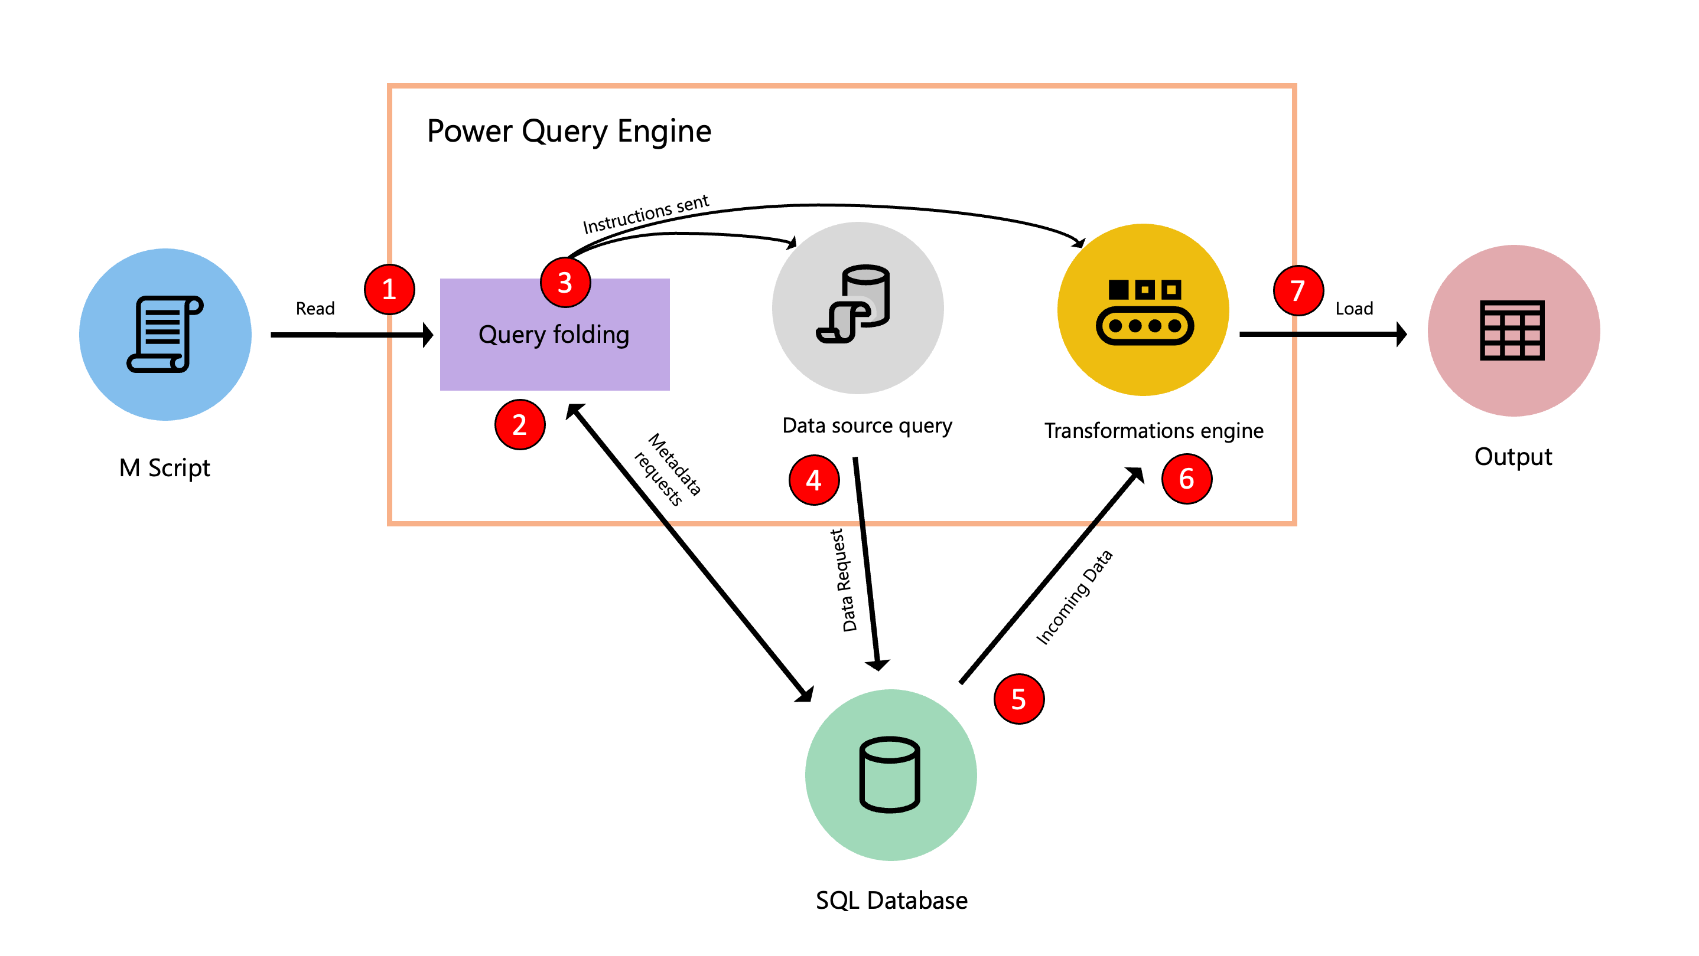
Query folding
The goal of query folding is to offload or push as much of the evaluation of a query to a data source that can compute the transformations of your query.
Notes:
The M script, found inside the advanced editor, is submitted to the Power Query engine. Other important information is also supplied, such as credentials and data source privacy levels.
The Query folding mechanism submits metadata requests to the data source to determine the capabilities of the data source, table schemas, relationships between different entities at the data source, and more.
Based on the metadata received, the query folding mechanism determines what information to extract from the data source and what set of transformations need to happen inside the Power Query engine. It sends the instructions to two other components that take care of retrieving the data from the data source and transforming the incoming data in the Power Query engine if necessary.
Once the instructions have been received by the internal components of Power Query, Power Query sends a request to the data source using a data source query.
The data source receives the request from Power Query and transfers the data to the Power Query engine.
Once the data is inside Power Query, the transformation engine inside Power Query (also known as mashup engine) does the transformations that couldn't be folded back or offloaded to the data source.
The results derived from the previous point are loaded to a destination.
https://learn.microsoft.com/en-us/power-query/query-folding-basics

Slide 31
What folds?
Folds
Generally things that have a SQL-equivalent (SELECT, SELECT AS, WHERE, GROUP BY, JOIN, UNION ALL) including:
  Renaming and removing columns
  Grouping and summarizing
  Filtering rows
Non-fuzzy merging
Pivoting and unpivoting (PIVOT and UNPIVOT operators).
Doesn’t Fold
Merging queries based on different sources.
Appending (union-ing) queries based on different sources.
Adding custom columns with complex logic. Complex logic implies the use of M functions that have no equivalent functions in the data source (e.g. LastN table filter).
Adding index columns.

Slide 32
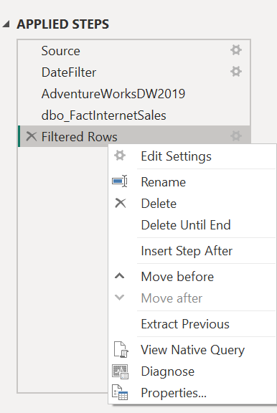
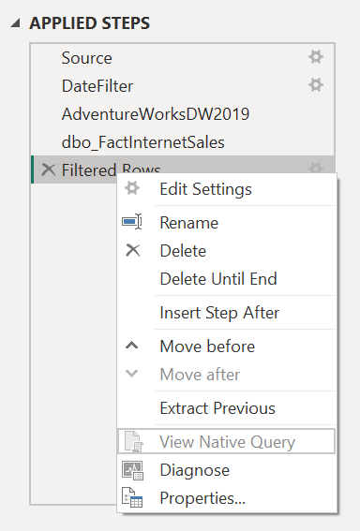
Does it fold?
For supported DBMS, you can check the Native Query. If it folds, it works.
If the View Native Query option isn't enabled (greyed out), this is evidence that not all query steps can be folded
Once a query fold breaks, it cannot be achieved again. Thus, if a query folds until step 4, but step 5 breaks it, step 6+ will not achieve benefits of query folding.
Notes:
https://learn.microsoft.com/en-us/power-query/power-query-folding

Slide 33
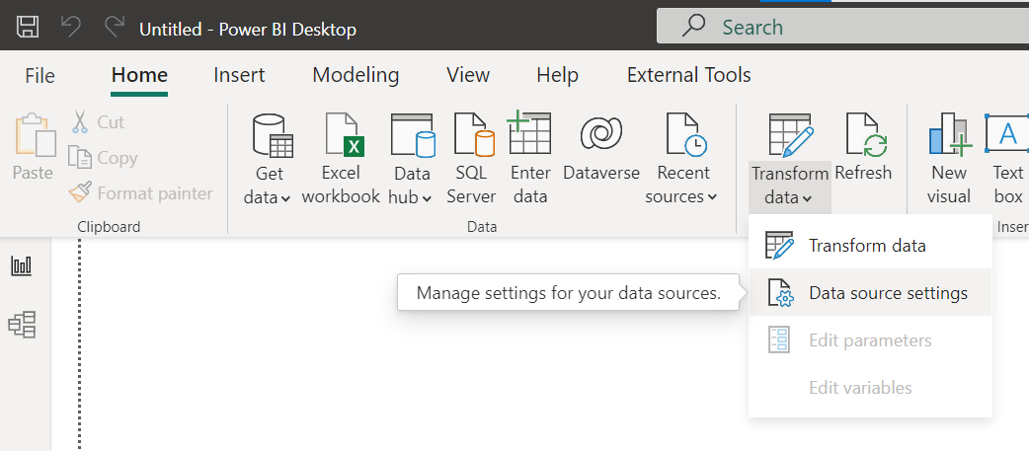
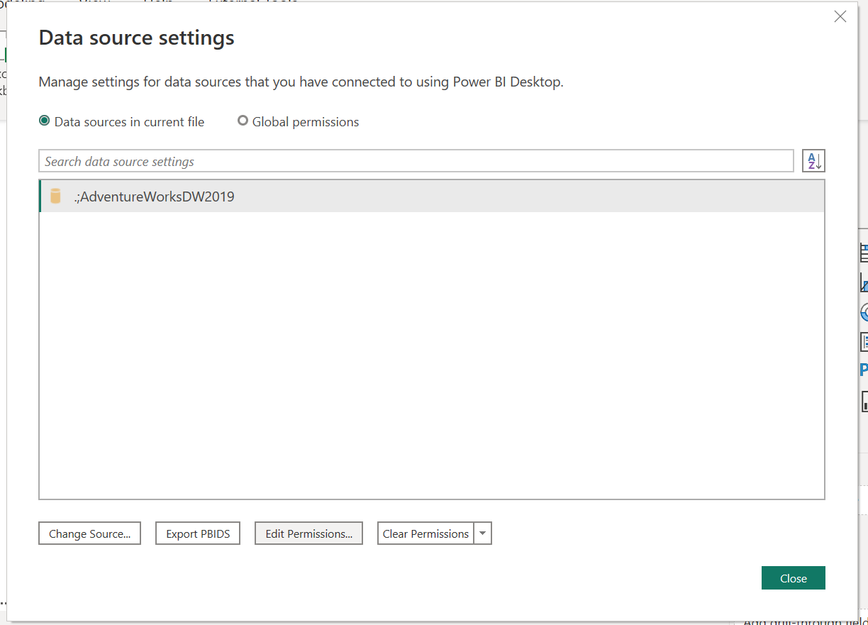
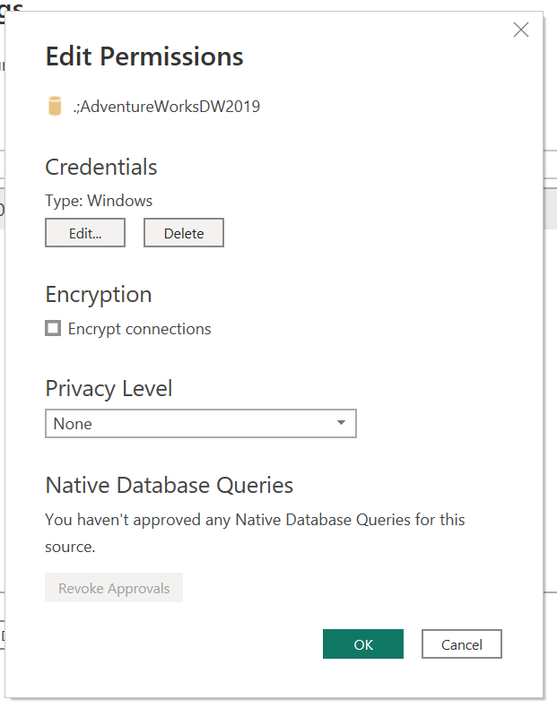
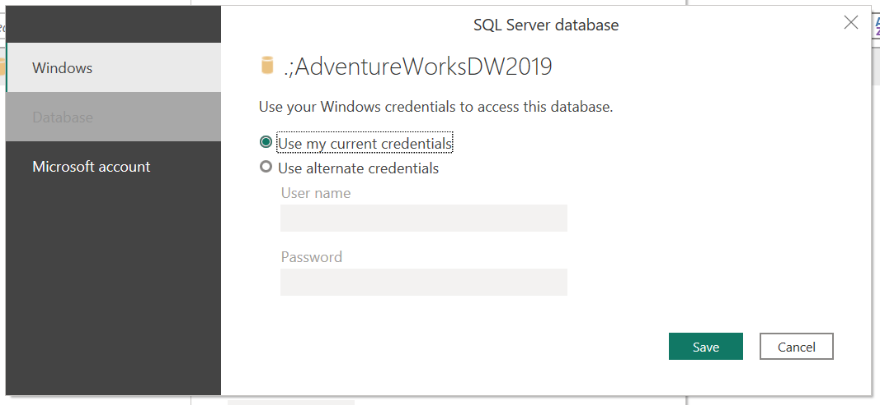
Authentication
Data source settings
Edit permissions
Choose different authentication settings
Controls what login credentials is used towards the data source

Slide 34
Privacy Levels
Privacy levels specify isolation levels that determine the degree to which one data source is isolated from other data sources.
None
Public
Organizational
Private
Notes:
For example, if you had a salary report that had a CPR number in it and you were querying employee salary data vs an online report of competitive payroll rates to do a comparison based on job titles, it is possible that Power Query would, rather than bring both data source in locally before merging, pass some personal info (names, CPR, etc) to the online source. => Set privacy levels to prevent this.

Slide 35
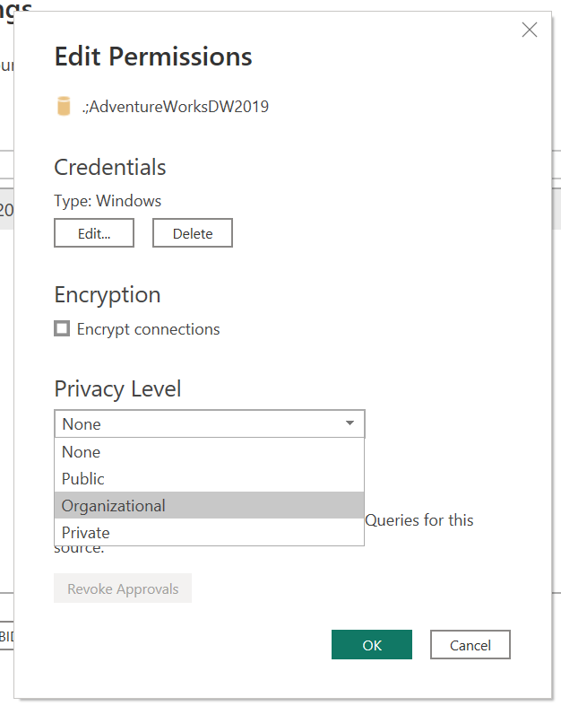
Privacy Levels
Privacy levels specify isolation levels that determine the degree to which one data source is isolated from other data sources.
None
  No privacy level set
Public
  Visible to all. Can fold into private and organizational.
Organizational
  An organizational data source is isolated from all public data sources, but can fold into a private data source
Private
  Contain sensitive or confidential information.
Notes:
None: The privacy level applied is inherited from a separate data source, or not applied if
the separate parent source has not been configured. For example, the privacy level for an
Excel workbook stored on a network directory could be set to None, yet the isolation level of
Private would be enforced if a data source for the root directory of the file is set to Private.
• Public: A public data source is not isolated from other public sources, but data transfer from
organizational and private data sources to public data sources is prevented. Public source
data can be transferred to an organizational data source but not to a private data source.
• Organizational: An organizational data source is isolated from all public data sources
but is visible to other organizational data sources. For example, if a CSV file is marked as
Organizational, then a query that integrates this source with an organizational SQL Server
database can transfer this data to the database server to execute the query.
• Private: A Private data source is completely isolated from all other data sources. Data
from the Private data source is not transferred to any other data sources, and data from
public sources is not transferred to the Private source.

Slide 36
Data model security
Controls “who can see what” in the data model
Different types:
  Table level security (e.g. restrict external user from seeing Grand Ledger postings)
  Column-level security (e.g. omit salary or other sensitive data from HR reports)
  Row-level security (e.g. let a category manager only see targets for the categories they are responsible for)
  More about this later

