Slide 1
Guess a fruit
An Unplugged Approach to Understanding AI

Slide 2
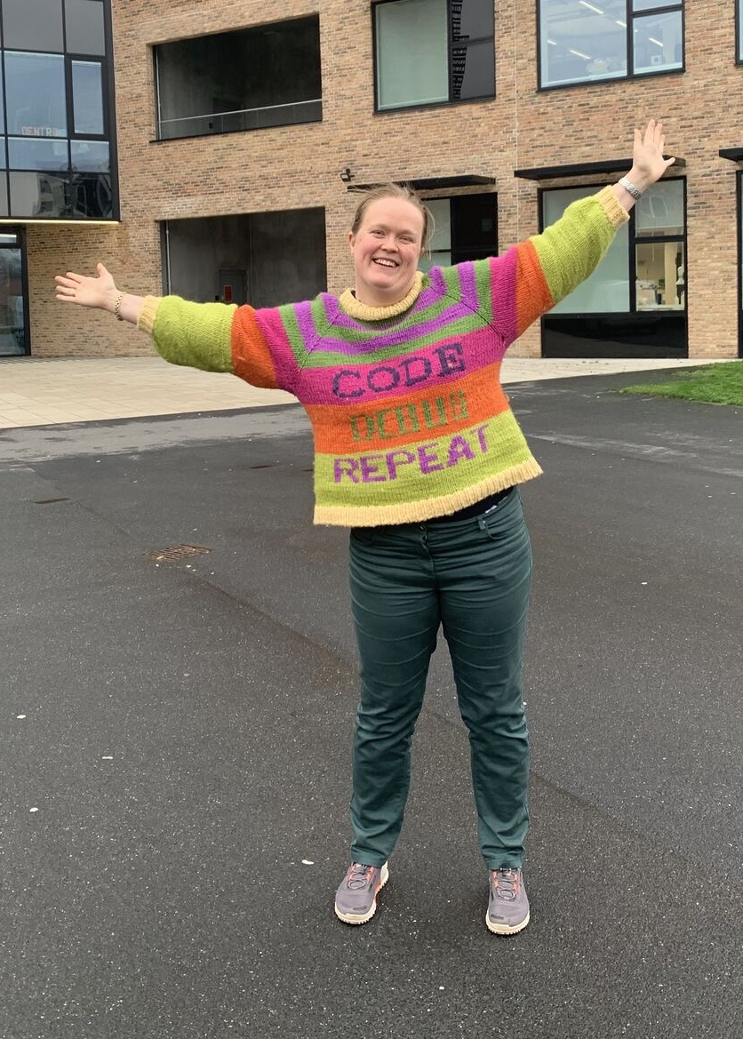
Who am I?
Astrid Hanghøj
Cand. Econ, Ph.D.
Lecturer in Software Engineering
E-mail: ahan@via.dk
https://www.linkedin.com/in/astridhanghoej/

Slide 3
Agenda
Introduction (10 minutes)
Game: Can you guess like a neural net? (15 minutes)
Conceptual mapping: Game > Theory (10 minutes)
Playful and unplugged approaches to CT (5 minutes)
Discussion (20 minutes)

Slide 4
Game: Can you guess like a neural net?
In a moment, you will have to guess a fruit without seeing or touching it.
You must solve the task in groups of five.
  One person is the output layer of the neural net: your responsibility is to guess which fruit it is.
  Four people will act as input layers: your responsibility is to pass on all the information you can observe to the net.
The game has two rules:
  Only the neural net is allowed to name fruits.
  The input layers are not allowed to show their cards to anyone.

Slide 5
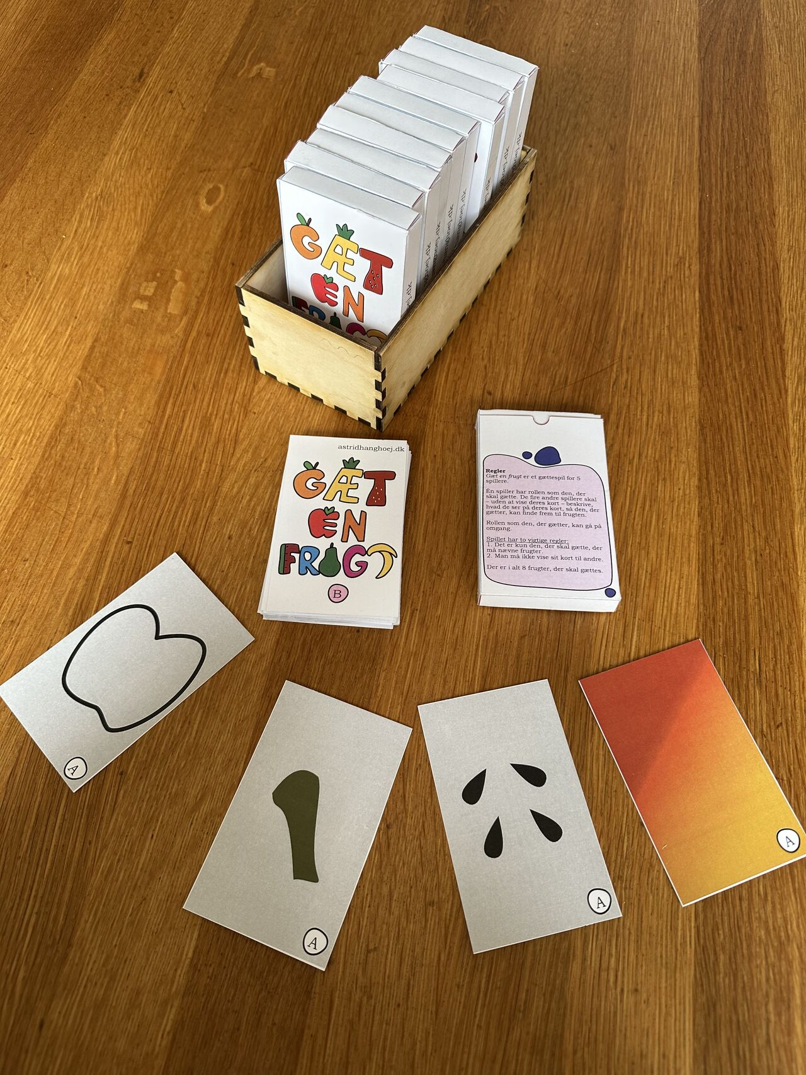
Guess a fruit
Each set of four cards represents a fruit that must be guessed.
The four A cards represent fruit A.
The four B cards represent fruit B.
And so on.
There are eight fruits in total.
You should get as far as you can in 15 minutes.
When we are finished playing, we will have a joint debrief.

Slide 6
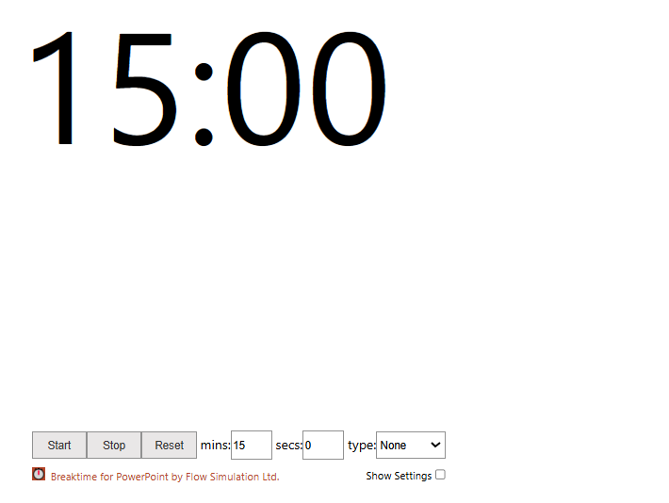
Gæt en frugt

Slide 7
Joint debrief: Reflections
How did you guess?
Was it the same thing (“feature”) that was decisive in your guess for each of the 8 fruits?

Slide 8
How does it relate to the game?
Color
Pineapple
Form
Apple
Stem
Watermelon
Seeds
Banana
Cherry

Slide 9




What is an image of a pineapple?

Slide 10
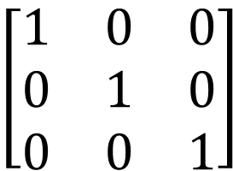
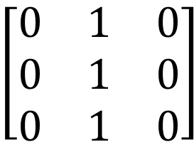
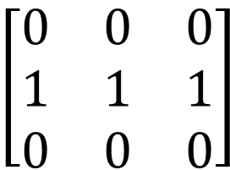
What is an image of a pineapple?
$$\left[\begin{matrix}0 & 0 & 0 \\ 1 & 1 & 1 \\ 0 & 0 & 0\end{matrix}\right]$$
$$\left[\begin{matrix}0 & 1 & 0 \\ 0 & 1 & 0 \\ 0 & 1 & 0\end{matrix}\right]$$
$$\left[\begin{matrix}1 & 0 & 0 \\ 0 & 1 & 0 \\ 0 & 0 & 1\end{matrix}\right]$$
Notes:
https://medium.com/@sanjay_dutta/exploring-filters-and-feature-maps-in-convolutional-neural-networks-cnns-b9ec65eb98b4

Slide 11
This is a pineapple.
(at least it needs to be for demonstrative purposes right now)

Slide 12
Diagonal lines

Slide 13
Horizontal lines

Slide 14
Vertical lines

Slide 15


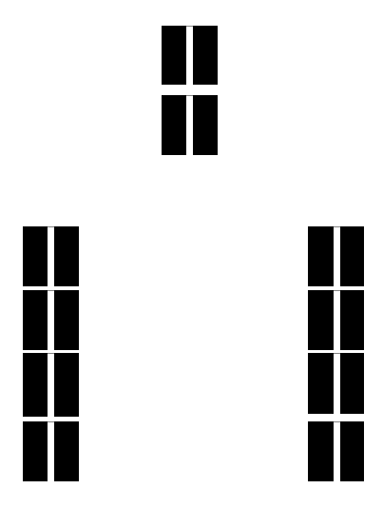
Putting it all together
Pineapple

Slide 16
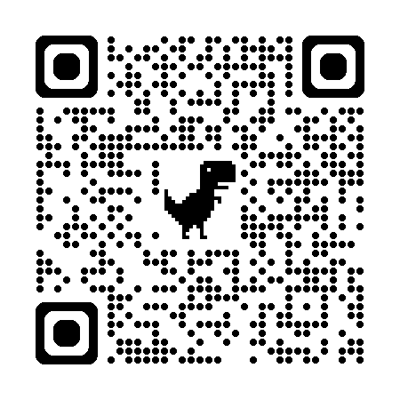
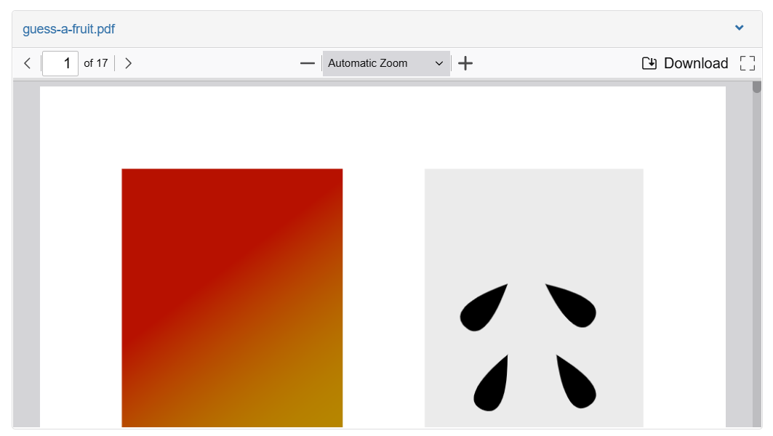
Print your own
Scan the QR code
Scroll down (or hit the button)
Push download button
Print (300g sheet paper in duplex)
Cut to fit
(or come by a grab a physical copy – limited supply)

Slide 17
Unplugged approaches
Benefits of unplugged (Busuttil & Formosa, 2020; Minamide et al., 2020):
  Low cost
  No need for a computer
  Teachers do not need ICT skills
  Ease of implementation
”Bodily acting” enforces the learning experience (Mikkonen, 2019)
Unplugged approaches are useful developing students CT skills (Chen et al., 2023)
Notes:
Chen: https://link.springer.com/content/pdf/10.1186/s40594-023-00434-7.pdf
Mikkonen: https://www.tandfonline.com/doi/pdf/10.1080/14606925.2019.1594967

Slide 18
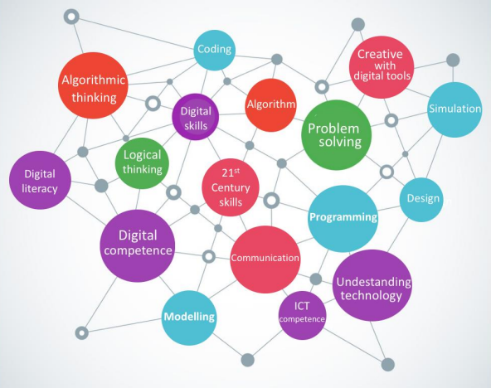
Nordic approach to CT
In Denmark: Technology comprehension part of the practical and musical subjects in compulsory education
Technology comprehension to cover
  Data and information
  Algorithms
  Programming
  Computer Systems
  Network and communication
  Human and computer interaction
  Design and development
  Digital creativity
  Modelling and simulations
  Privacy and security
  Empowerment
Ct-related terms used in nordic countries’ education policy documents
Notes:
Pratical and musical subjects (music, physical education, arts, etc) typically have a more creative and explorative approach to didactics
https://uvm.dk/media/y04do413/180221-computhinknordic.pdf
https://uvm.dk/media/qawgtii2/240819ole-sejer-iversen-oplaeg-for-ekspertgruppe-for-fagfornyelsen-om-teknologiforstaaelse.pdf

Slide 19
Discussion
What learning objectives could this game – or other unplugged approaches - support in your educational context?
What risks do you see in unplugged approaches—and how might they be mitigated?
Where could unplugged CT sit in your curriculum?

